Slide 1
Company feedback Analysis
Group members: Shiv Jariwala
Richard Martinez
Mayur Patel
Ziding Zhao

Slide 2
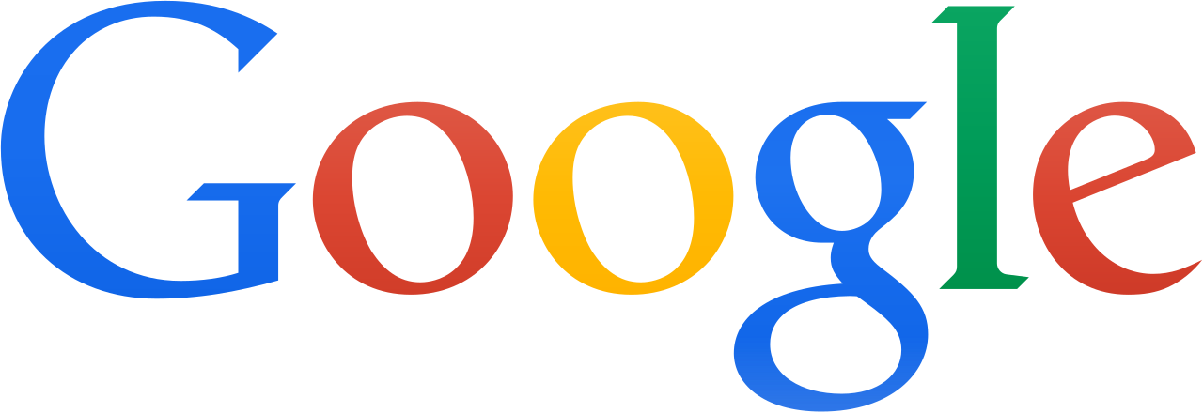


Our Project
Took a large dataset from Dominant companies
Saw how employees felt about working for those companies respectively
Saw the ratings of those companies over time
Found the most frequent Pros and Cons of each company
Future predictions

Slide 3
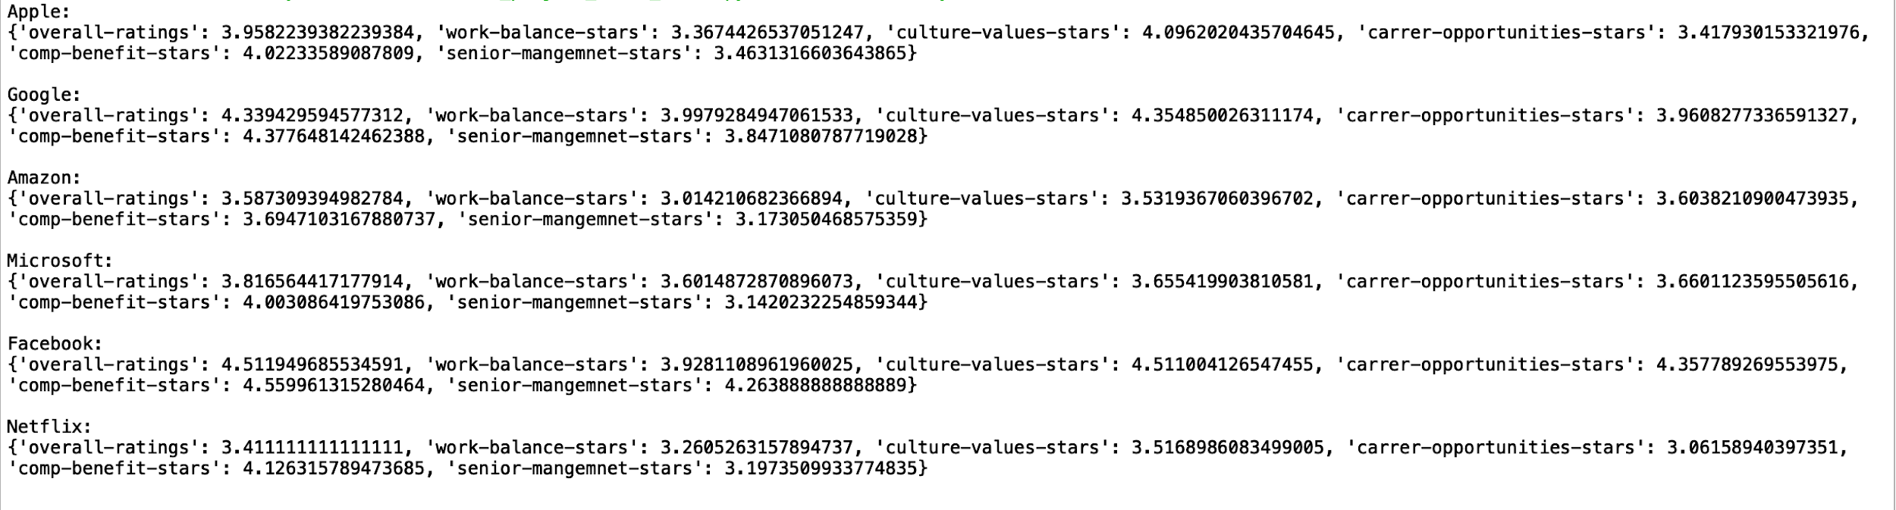
Purpose Code
We found the overall score of each company, and individual score of each category for each company.
Created time series models that plotted the overall scores of each company over time
Used text mining to see which Pros and Cons came up the most in the employee reviews

Slide 4
Average Ratings of Companies
Companies | Overall | Work-balance | Career-opportunities | Company-benefit | Culture-value | Senior-management
Apple | 3.96 | 3.37 | 3.42 | 4.02 | 4.10 | 3.46
Google | 4.34 | 4.00 | 3.96 | 4.38 | 4.35 | 3.85
Amazon | 3.59 | 3.01 | 3.60 | 4.00 | 3.53 | 3.14
Microsoft | 3.82 | 3.60 | 3.66 | 4.00 | 3.66 | 3.14
Facebook | 4.51 | 3.93 | 4.36 | 4.56 | 4.51 | 4.26
Netflix | 3.41 | 3.26 | 3.06 | 4.13 | 3.52 | 3.20
Notes:
Facebook did well on almost all variables ratings

Slide 5
Big events happened at 2011
Financial crisis at 2010, an apparent economic recovery at the end of 2010. High optimism in the financial markets, a succession of natural disasters, economic disappointment and government failures led to the most volatile year
Amazon adds video to Amazon Prime premium subscription as it begins to take over Netflix
Netflix starts it international streaming service at Brazil and Mexico
Google: Acquisition of Motorola Mobility
Microsoft: launched Office 365

Slide 6
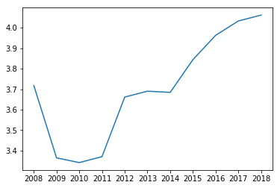
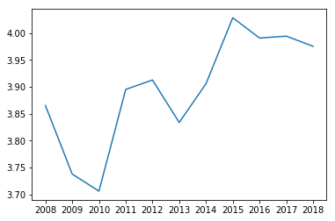
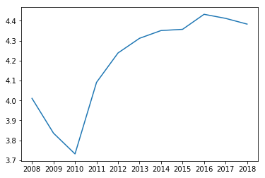
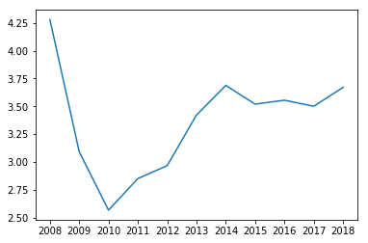
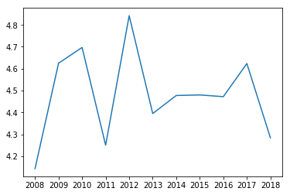
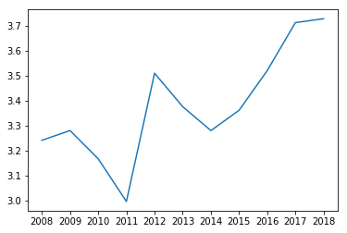
Graphs of overall-ratings
Microsoft overall-ratings
Apple overall-ratings
Google overall-ratings
Netflix overall-ratings
Facebook overall-ratings
Amazon overall-ratings
Notes:
1. Financial crisis at 2011, from an apparent economic recovery at year end 2010 and high optimism in the financial markets, a succession of natural disasters, economic disappointments, and government failures led to the most volatile year in stock market history.
2. Amazon adds video to its Amazon Prime premium subscription as it begins to take on Netflix.

Slide 7
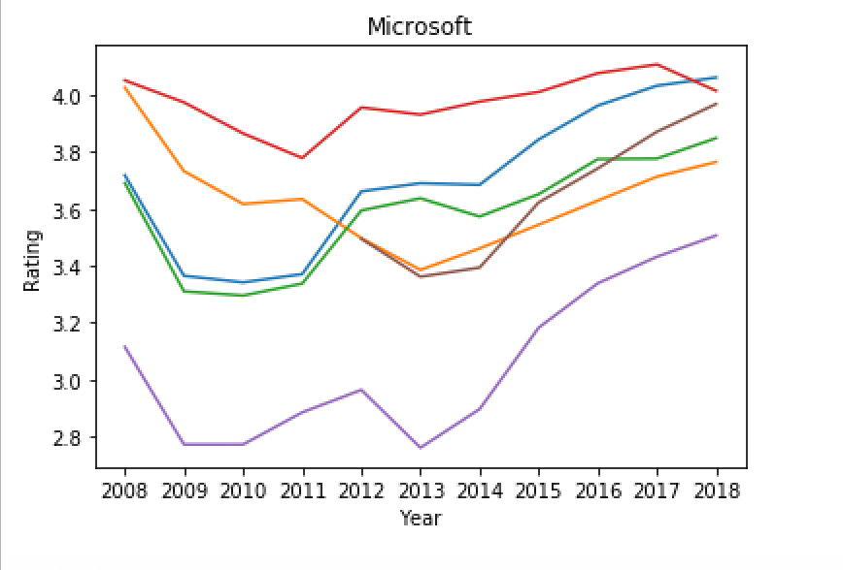
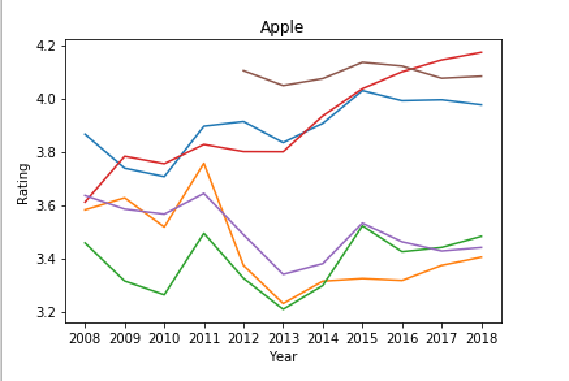
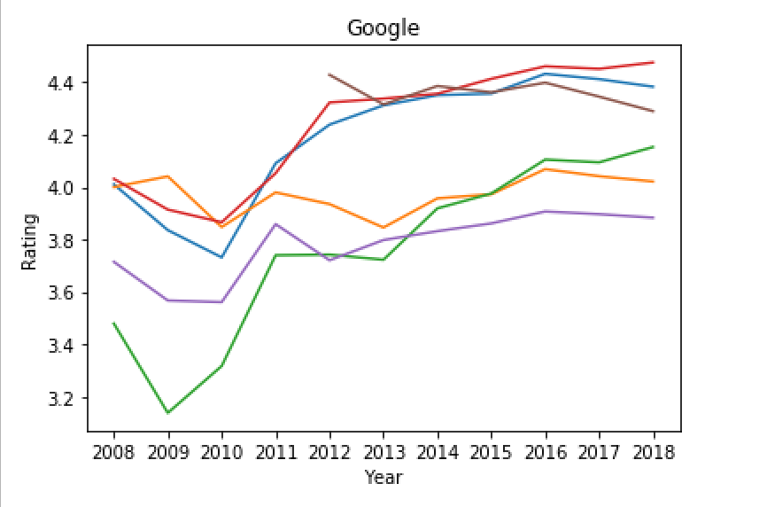
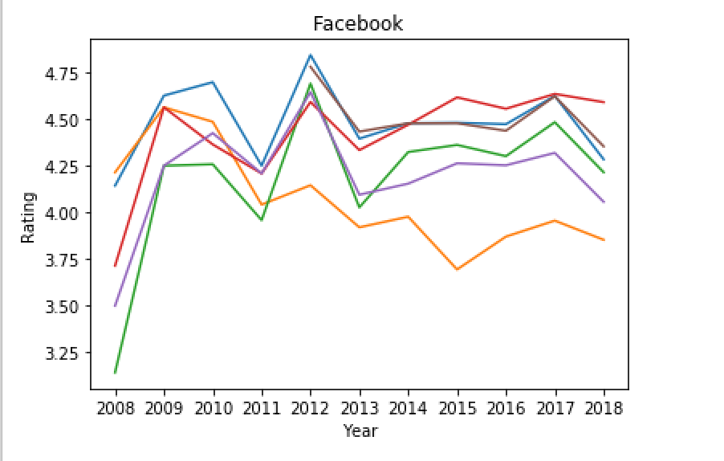
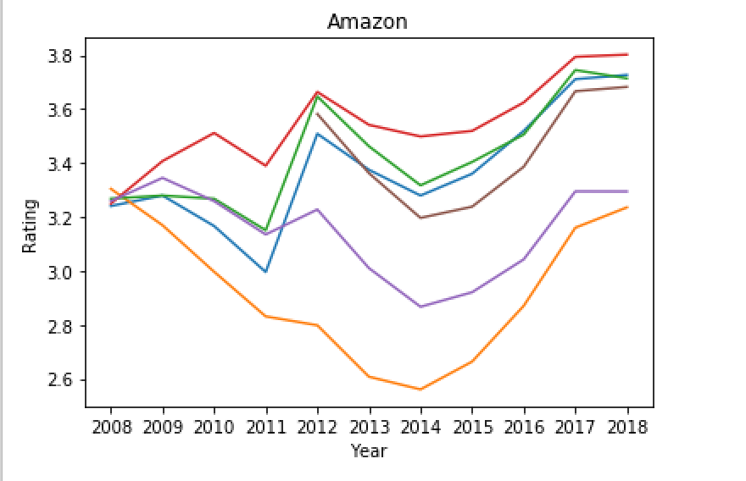
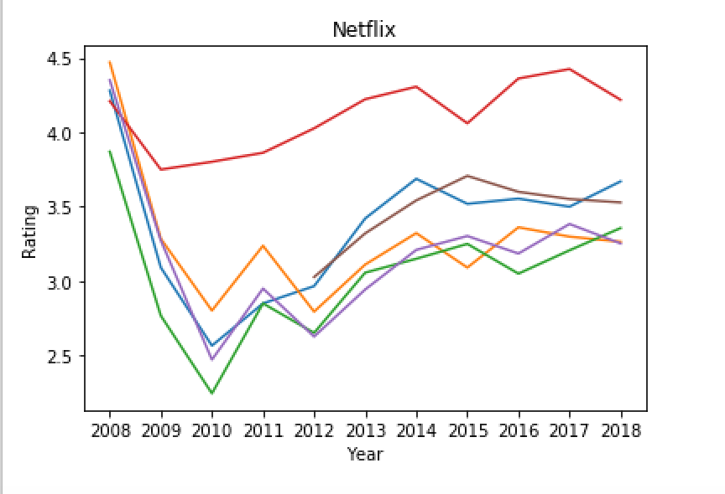
Graphs
Blue = overall Orange = work balance Green = career opportunities
Red = comp benefits Purple = senior management Brown = culture values

Slide 8
Text Mining the Pros and Cons (Code)
for string in data[column]:
for word in string.split():
if word not in stop_words:
try: d[word] += 1 # Adds 1 if word is repeated
except: d[word] = 1 # Adds new word to dictionary
for k, v in sorted(d.items(), key=lambda value: value[1]): print ("%s: %d" % (k, d[k]))
for company in companies:
data = df.loc[df['company'] == company]
common_words(data,'pros')
common_words(data,'cons')

Slide 9

Apple Text Mining Results
Pros:
products: 1781
pay: 1855
environment: 1882
company: 2566
apple: 2990
good: 3415
people: 3958
benefits: 4304
work: 5253
great: 7436
Cons:
customers: 1479
hours: 1832
people: 1846
company: 1872
get: 2138
time: 2183
retail: 2412
management: 2470
apple: 2652
work: 3957
Pros:
apple is a great company: 23
get to work from home: 28
good company to work for: 28
apple is a great place: 29
even for part time employees: 33
benefits even for part time: 40
work with some of the: 51
people you work with are: 55
great people to work with: 100
great company to work for: 116
Cons:
part time to full time: 11
working from home can be: 13
move up within the company: 13
work life balance is not: 14
difficult to move up in: 16
work life balance can be: 19
end of the day it: 22
hard to move up in: 24
move up in the company: 39
none that i can think: 44

Slide 10

Google Text Mining Results
Pros:
smart: 1112
food: 1314
google: 1336
company: 1402
benefits: 1479
perks: 1504
good: 2240
people: 2700
work: 3524
great: 3662
Cons:
time: 709
management: 763
many: 767
hard: 782
big: 789
get: 1045
people: 1263
google: 1412
company: 1711
work: 1990
Pros:
smartest people in the world: 13
great place to work and: 13
great place to work at: 14
google is a great place: 15
people to work with and: 17
best company to work for: 21
smart people to work with: 31
work with some of the: 36
great company to work for: 40
great people to work with: 41
Cons:
think there are any cons: 9
reallyno cons reallyno cons reallyno: 9
nothing i can think of: 10
nothing that i can think: 10
cons reallyno cons reallyno cons: 10
easy to get lost in: 11
hard to get things done: 14
google is a big company: 17
work life balance can be: 19
none that i can think: 31

Slide 11

Amazon Text Mining Results
Pros:
get: 2724
environment: 3208
pay: 4159
benefits: 4191
company: 4284
amazon: 4299
people: 5143
great: 7428
good: 8840
work: 11983
Cons:
long: 2863
life: 2951
company: 3318
people: 3936
hours: 3936
amazon: 3975
time: 3991
management: 4043
get: 4364
work: 11244
Pros:
great place to work and: 36
work hard have fun make: 39
hard have fun make history: 41
good company to work for: 45
amazon is a great place: 50
get to learn a lot: 51
smart people to work with: 56
work with some of the: 68
great people to work with: 85
great company to work for: 93
Cons:
get to the break room: 23
need to be able to: 23
work life balance is a: 24
work life balance is non: 25
none none none none none: 25
long hours on your feet: 33
move up in the company: 37
none that i can think: 43
work life balance can be: 69
work life balance is not: 73

Slide 12

Microsoft Text Mining Results
Pros:
opportunities: 2146
balance: 2236
smart: 2549
microsoft: 2601
company: 4259
people: 5584
benefits: 5906
good: 7524
great: 8165
work: 9202
Cons:
time: 1784
politics: 1833
much: 1958
many: 2181
microsoft: 2339
get: 2609
people: 2865
management: 2877
company: 4116
work: 4557
Pros:
good work life balance and: 36
work with a lot of: 36
benefits and work life balance: 38
microsoft is a great place: 39
work life balance is good: 48
benefits good work life balance: 49
work with some of the: 68
great people to work with: 90
smart people to work with: 107
great company to work for: 114
Cons:
difficult to get things done: 15
takes a long time to: 16
gets in the way of: 19
work life balance is not: 19
hard to get things done: 20
work life balance is a: 21
easy to get lost in: 23
none that i can think: 28
get in the way of: 35
work life balance can be: 46

Slide 13

Facebook Text Mining Results
Pros:
food: 294
good: 321
perks: 369
benefits: 380
facebook: 402
culture: 417
company: 551
great: 731
people: 862
work: 998
Cons:
really: 165
hard: 167
time: 178
life: 186
balance: 191
get: 211
facebook: 225
people: 378
company: 390
work: 606
Pros:
mission to connect the world: 5
freedom to work on what: 5
smartest people i have ever: 5
freedom to work on projects: 6
great people to work with: 6
hundreds of millions of people: 8
smart people to work with: 10
making the world more open: 10
work with some of the: 12
world more open and connected: 17
Cons:
company has grown a lot: 3
need to be able to: 3
balance can be a challenge: 4
life balance can be challenging: 4
work life balance is not: 5
none that i can think: 5
hard to keep up with: 6
none i can think of: 6
life balance can be a: 10
work life balance can be: 18

Slide 14

Netflix Text Mining Results
Pros:
benefits: 144
culture: 159
free: 190
company: 211
people: 219
pay: 220
good: 223
netflix: 229
work: 312
great: 356
Cons:
like: 146
culture: 170
job: 182
company: 190
time: 197
management: 200
get: 234
netflix: 241
work: 276
people: 289
Pros:
like an adult you are: 3
freedom to do what you: 3
great company to work for: 3
good pay for the work: 3
best place i ve ever: 3
freedom to do your job: 3
given the freedom to do: 3
culture of freedom and responsibility: 3
netflix is a great place: 3
place i ve ever worked: 4
Cons:
far as i am concerned: 2
impossible to get time off: 2
sounds good on paper but: 2
100% true in all cases: 2
everyone is supposed to work: 2
may not be the place: 2
never know when you will: 2
know when you will be: 2
none that i can think: 3
culture of fear is real: 3

Slide 15
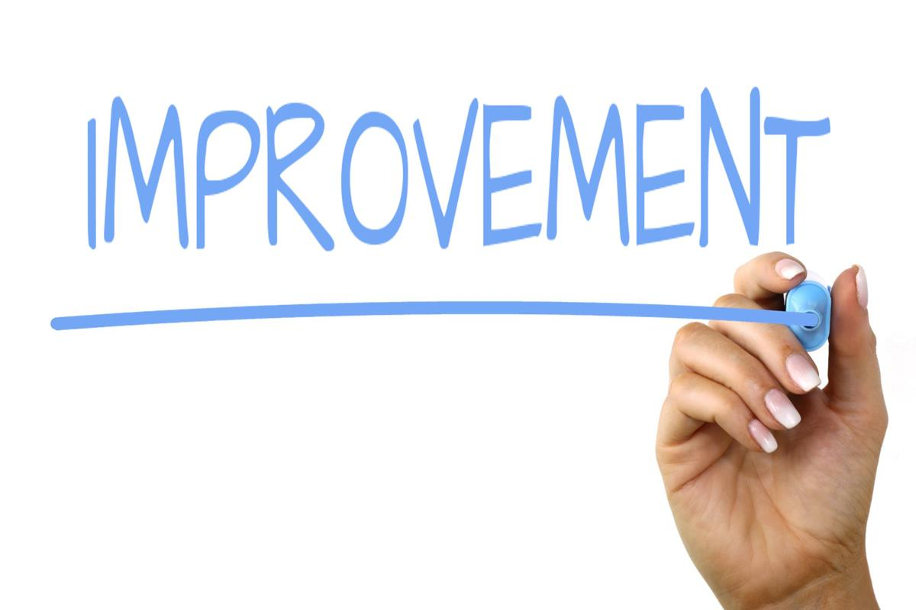
Conclusion
Not all people view things the same way
Facebook received a good feedback overall
Netflix did not receive good feedback overall
Use this model to forecast for future improvement
Facebook needs to improve work balance
Amazon needs to improve work balance
Apple needs to improve work balance, senior management, and career opportunities
Google needs to improve career opportunities
Microsoft needs to improve senior management
Netflix needs to improve on everything besides company benefits
Use text mining for improvement

